Slide 1
Design of an Optimal Network for the University of Lahore Campus
M N M Nuzky
70141107
K F M Fazeen Shahfan
70141328
Ahamed Najah
70141084
Engr.Abeera
Department of Computer Engineering

Slide 2
Outline
Introduction
Literature Review
Problem Statement
Aims and Objectives
Methodology
Expected Outcomes and Applications
Estimated Budget
Gantt Chart
References

Slide 3
Introduction
The University of Lahore requires a reliable wired network to meet growing connectivity demands across its departments, library, and offices. This project aims to design a scalable network leveraging a 50 Mbps fiber optic connection, with automated IP configuration via DHCP and a structured topology. The network will ensure fair bandwidth distribution, seamless connectivity, and enhanced productivity while fostering collaboration and data integrity.

Slide 4
Literature Review
Studies highlight the importance of scalable and efficient networks for academic institutions. Key insights include configuring switches and routers for bandwidth optimization (Cisco, 2011), automating IP configuration via DHCP (Kumar et al., 2019; Gupta & Sharma, 2021), and minimizing the environmental impact of networks (Ahmed & Khan, 2020). Chen & Zhang (2020) emphasize IoT integration for secure, modern campus networks. These findings guide the design of a robust, tailored solution for the University of Lahore.

Slide 5
Problem Statement
The University of Lahore's current network faces challenges such as inefficient wired connectivity, lack of bandwidth management, and the absence of automated IP configuration, leading to resource allocation issues and reduced productivity. This project aims to design a scalable and efficient network solution tailored to address these specific needs.

Slide 6
Aims and Objectives
List the primary goals of your project:
To design a robust network topology that ensures optimal wired connectivity.
To implement automated IP configuration using DHCP for all users.
To manage bandwidth efficiently and ensure fair usage across all systems.
To assess the societal and environmental impact of the proposed solution.

Slide 7
Methodology
Phase 1: Network Requirements Analysis and Design
Identify campus networking needs, address challenges like bandwidth bottlenecks and IP conflicts, design scalable topology, and select suitable hardware with optimized subnetting.
Phase 2: Core Network Setup and Configuration
Implement the network with routers, switches, and access points; configure DHCP, VLANs, and routing protocols; test components to ensure functionality and design adherence.
Phase 3: Final Integration, Testing, and Impact Assessment
Integrate all components, test for seamless communication, optimize performance, resolve issues, and assess environmental and societal impacts for deployment readiness.

Slide 8
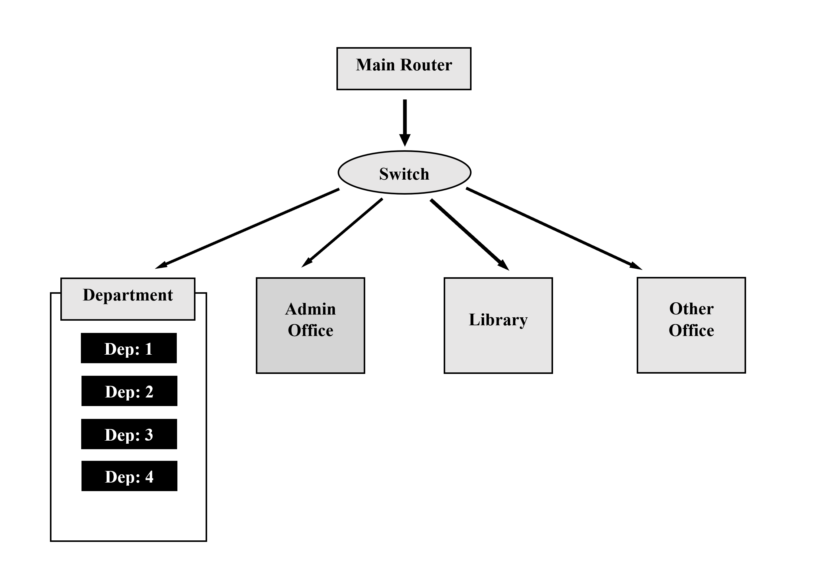
Block Diagram

Slide 9
Expected Outcomes and Applications
A fast, scalable network with automated IP management, fair bandwidth distribution, and eco-friendly devices will enhance connectivity across campus. It will support online learning, research, administration, and security systems while enabling future technologies like IoT and AI for a smart campus vision.

Slide 10
Estimated Budget
estimated cost of the project is zero.

Slide 11
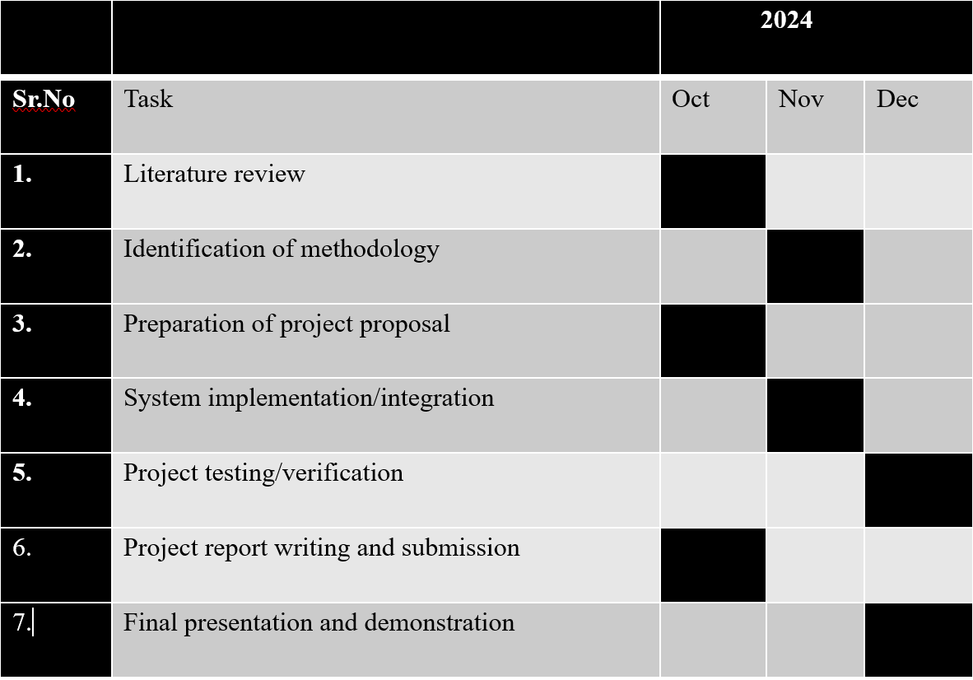
Gantt Chart

Slide 12
References
A. S. &. W. D. J. Tanenbaum, "Computer Networks," 2011.
Kumar, "bandwidth optimizations & automated IP configuration," 2019.
G. R. &. S. P, "Advance networking Solutions for the university," 2021.
4. Z. A. &. H. khan, "Environmental impects of network implementations," 2020.
5. Y. Z. &. L. Chen, IOT Itegration in Educatioanal Network, 2020.

Slide 13


Slide 14
Thank You!!!

